Slide 1
iCredit Sp. z o.o.
Poland
Key performance indicators 2020

Slide 2
2020 for iCredit Poland
18 106 credits sold in period 01.01.2020-31.12.2020
Further expanding – opening new regions.
Further development of the new project of iCredit – Money Shops
Technological development:
improvement of internet marketing;
new payment method – online;
in second half of the year further development of the company’s operating activities ( e.g score card, loan disbursement process)
Extending the offer with new additional services allowing to keep the revenue at a similar level after the government reduced NIC limit due to COVID.

Slide 3
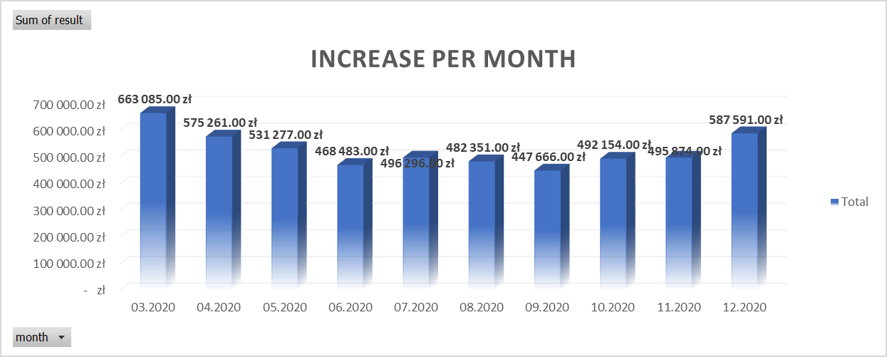
Delays results
Even in the worst crysis month , the collection remain pretty much stable .After critical moment in March, the monthly increase of delays started even to decrease. By the end of the year the increase is due to significant increase of turnovers.

Slide 4
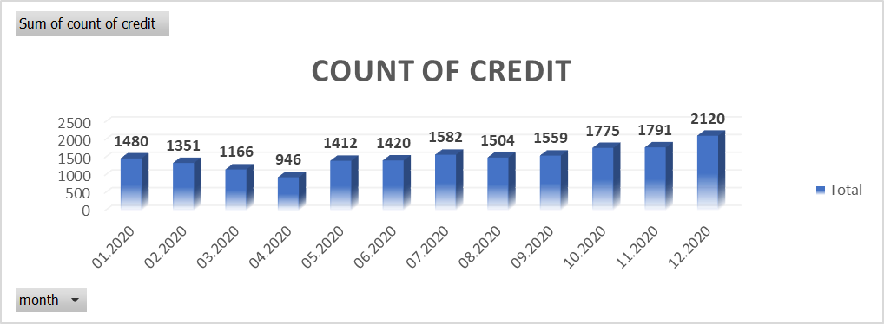
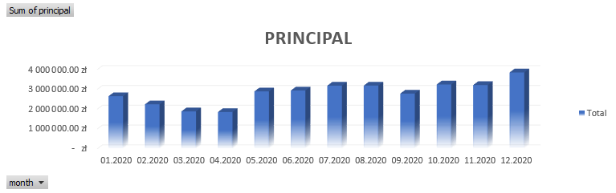
Sales 2020
The company remain stable. Sales are increasing month by month.

Slide 5
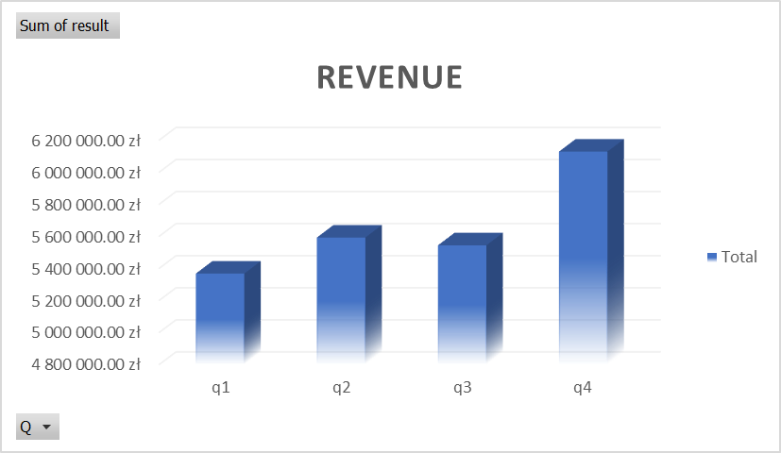
Income from revenue 2020
Despite the crisis on the market and the government’s reduction of the NIC limit, iCredit has increase of revenue during 2020.

Slide 6
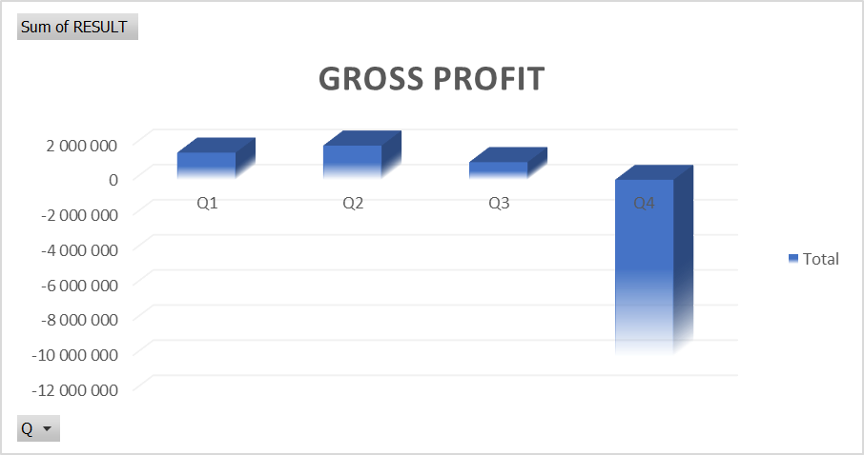
Gross profit/loss 2020
The difference between the sales profit and the loss (gross and net) is mainly caused by the statutory necessity of the so-called prudent actions of the Management Board of the Company at the end of the year, consisting in:
Create impairments on certain loan receivables (additional cost 7 331 000PLN)
Valuation of liabilities in foreign currencies at the exchange rate announced by the NBP (the National Bank of Poland) as at December 31, 2020 (additional cost 1 820 000 PLN).

Slide 7
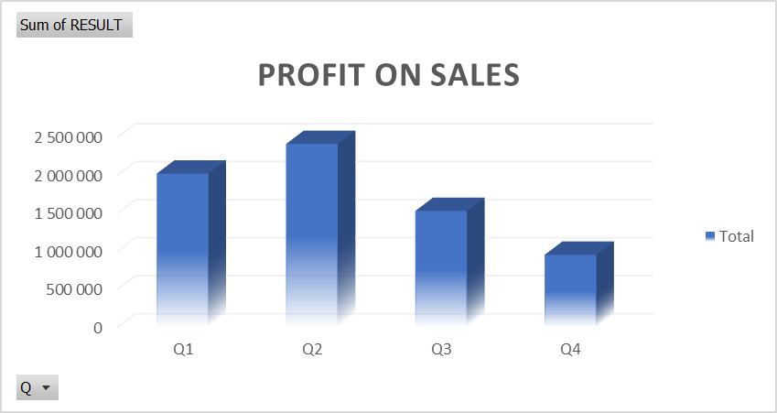
PROFIT ON SALES
Profit on sales decreased due to the change in the structure of the loan portfolio-increasing the share of loans with obligatorily limited non-interest loan costs (from 01.04.2020 up to 25%).

Slide 8
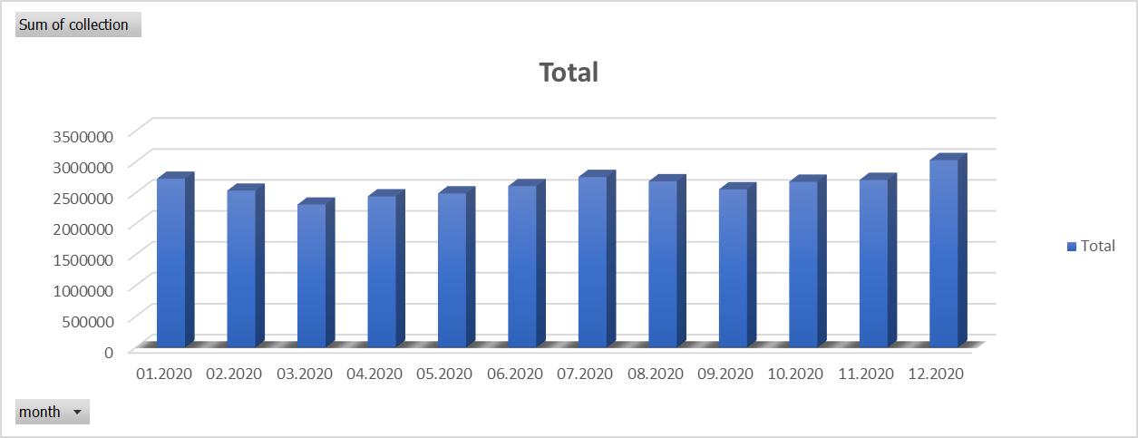
Collection 2020
In spite of the hard situation during the covid crisis, drop of collection was not significant. Since march there is increasing trend.

Slide 9
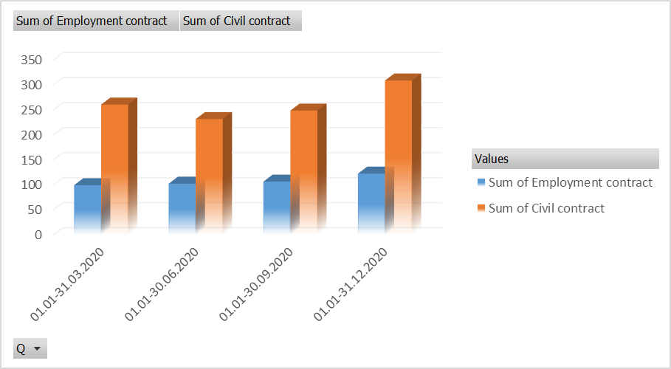
Numbers of employees: employment contract and civil contract
During 2020 the company’s development is visible not only in sales, but also in number of employees. We opened two new voivodships, which resulted in an increase in employment.

Slide 10
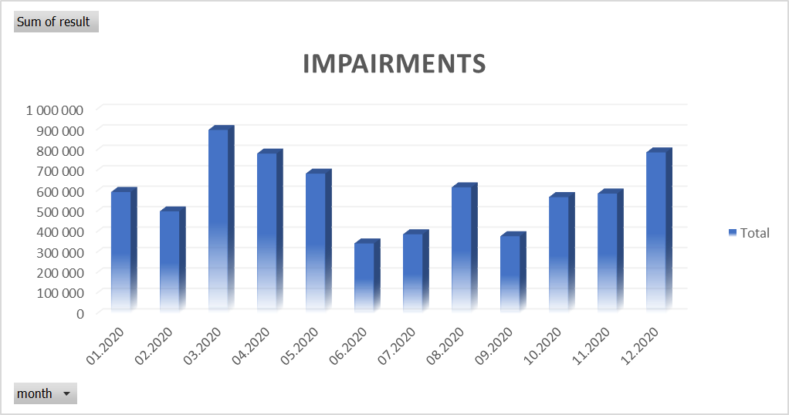
Monthly increase of impairments 2020
After critical moment in march, monthly increase of impairments didn’t reach this level later.

Slide 11
iCredit Poland
INTERNATIONAL STANDARD
www.icredit.pl

